Slide 1


Deterministic (Chaotic)
Perturb & Map
Max Welling
University of Amsterdam
University of California, Irvine

Slide 2
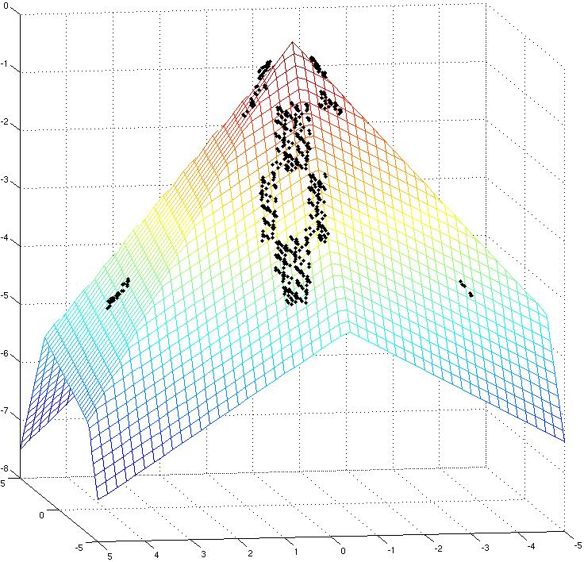
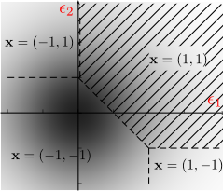
Overview
Introduction herding though joint image segmentation and labelling.
Comparison herding and “Perturb and Map”.
Applications of both methods
Conclusions

Slide 3

Example:
Joint Image Segmentation and Labeling
“people”

Slide 4

Step I: Learn Good Classifiers
A classifier : images features X → object label y.
Image features are collected in square window around target pixel.

Slide 5
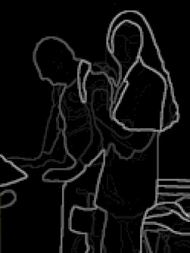
Step II: Use Edge Information
Probability : image features /edges → pairs of object labels.
For every pair of pixels compute the probability that they cross an object boundary.

Slide 6

Step III: Combine Information
How do we combine classifier input and edge information into a segmentation algorithm?
We will run a nonlinear dynamical system to sample many possible segmentations
The average will be out final result.

Slide 7


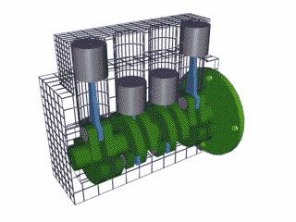
The Herding Equations
(y takes values {0,1} here for simplicity)
average

Slide 8
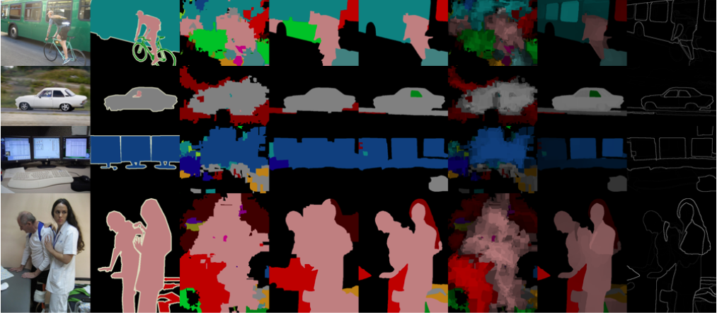
Some Results
ground
truth
local
classifiers
MRF
herding

Slide 9
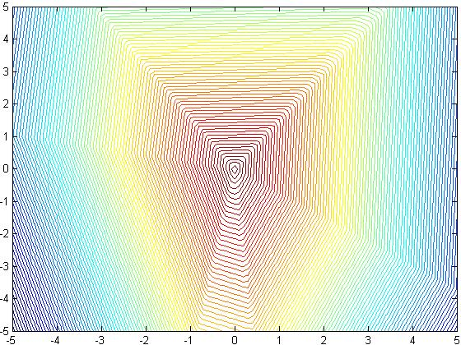
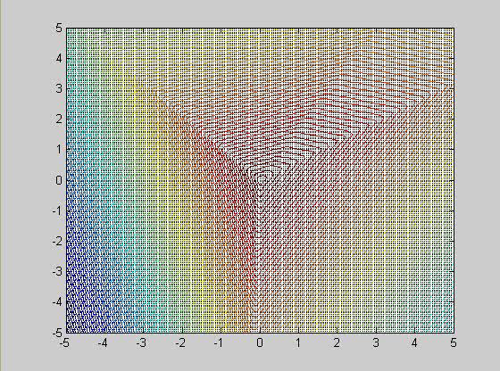
Dynamical System
The map represents a weakly chaotic nonlinear dynamical system.
y=1
y=6
y=2
y=5
Itinerary:
y=[1,1,2,5,2,…
y=3
y=4

Slide 10
Geometric Interpretation

Slide 11
Convergence
Translation:
Choose S_{t} such that:
Then:
Equivalent to “Perceptron Cycling Theorem”
(Minsky ’68)
s=1
s=6
s=[1,1,2,5,2...
s=2
s=5
s=3
s=4

Slide 12
Perturb and MAP
Papandreou & Yuille, ICCV - 11
-Learn offset:
using moment
matching
-Use Gumbel PDFs
To add noise
State: s2
State: s3
State: s1
State: s4
State: s6
State: s5

Slide 13
PaM vs. Frequentism vs. Bayes
Given some likelihood P(x|w), how can you determine a predictive distribution P(x|X)?
Given dataset X, and sampling-distr. P(Z|X), a bagging frequentist will:
Sample fake data-set Z_t ~ P(Z|X) (e.g. by bootstrap sampling)
Solve w*_t = argmax_w P(Z_t|w)
Prediction P(x|X) ~ sum_t P(x|w_t*)/T
Given a dataset X, and prior P(w) Bayesian will:
Sample w_t~P(w|X)=P(X|w)P(w)/Z
Prediction P(x|X) ~ sum_t P(x|w_t)/T
Given a dataset X, and perturb-distr. P(w|X), a “pammer” will:
Sample w_t~P(w|X)
Solve x*_t=argmax_x P(x|w_t)
Prediction P(x|X) ~ Hist(x*_t)
Herding uses deterministic,
chaotic perturbations instead

Slide 14
Learning through Moment Matching
Papandreou & Yuille, ICCV - 11
PaM
Herding

Slide 15
PaM vs. Herding
Papandreou & Yuille, ICCV - 11
PaM
PaM converges to a fixed point.
PaM is stochastic.
At convergence, moments are
matched:
Convergence rate moments:
In theory, one knows P(s)
Herding
Herding does not converge to
a fixed point.
Herding is deterministic (chaotic).
After “burn-in”, moments are
matched:
Convergence rate moments:
One does not know P(s) but it’s
close to max entropy distribution.

Slide 16
Random Perturbations are Inefficient!
w_{i}
Average Convergence of 100-state system with random probabilities
log-log plot
IID sampling from
multinomial distribution
herding

Slide 17
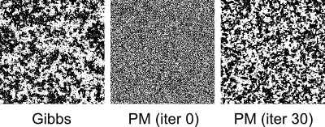
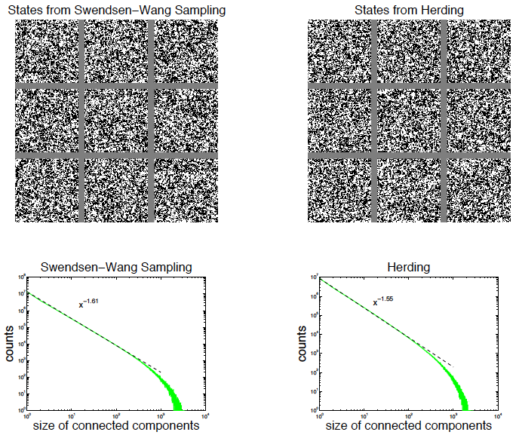
Sampling with
PaM / Herding
PaM
herding

Slide 18
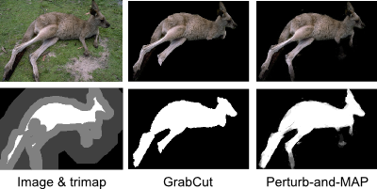
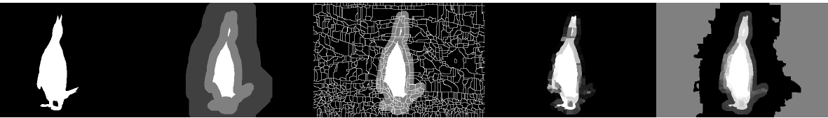
Applications
Chen et al. ICCV 2011
herding

Slide 19
Conclusions
PaM clearly defines probabilistic model, so one can
do maximum likelihood estimation [Tarlow. et al, 2012]
Herding is a deterministic, chaotic nonlinear dynamical
system. Faster convergence in moments.
Continuous limit is defined for herding (kernel herding)
[Chen et al. 2009]. Continuous limit for Gaussians also
studied in [Papandreou & Yuille 2010]. Kernel PaM?
Kernel herding with optimal weights on samples =
Bayesian quadrature [Huszar & Duvenaud 2012]. Weighted PaM?
PaM and herding are similar in spirit:
Define probability of a state as the total density in a certain
region of weight space. Both use maximization to compute
membership of a region. Is there a more general principle?

